Slide 1


Team DATA PILOTS AI/ML DocAssist

Slide 2


DocAssist
ML & AI solution which facilitates the written and verbal communication between physician and patient

Slide 3
ABOUT THE Team
Rahul Agarwal
Saurabh Rai
Mayank Saini
Saurabh Pal
Manish Lohani

Slide 4
PROBLEM STATEMENT Sometimes, the relation between signs /symptoms and the disease is not so apparent. It’s mostly based on physician’s best judgement till additional lab tests are performed. There is a need for a software solution to assist the physician in making the best clinical judgement for more efficient care and control costs for patients and families.
Our solution : DocAssist
Our solution gives the power of machine learning to the physician to make best clinical judgement. It also facilitates the patient-physician consultation using an application interface which allows both textual and verbal communication. Uses Speech-to-text and matching to tag symptoms and diseases. It suggests the physician the most probable diseases from the symptoms. Also suggests the most probable symptoms for the disease which helps the physician ask additional questions.

Slide 5
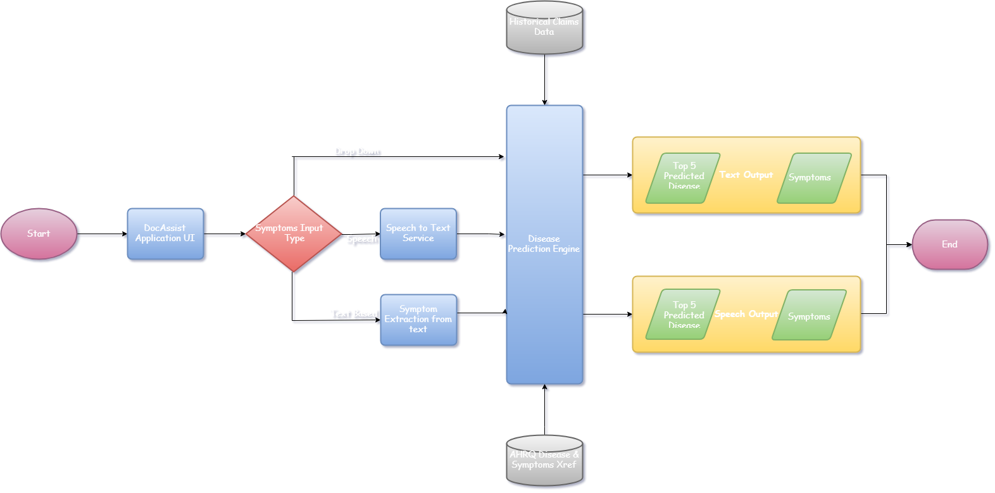
ARCHITECTURE & DATA FLOW DIAGRAM

Slide 6


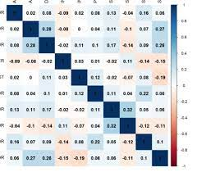


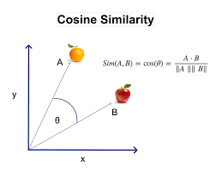
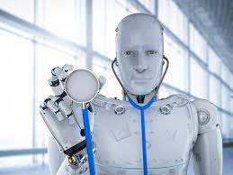
Disease Prediction Engine Common Symptoms for diseases
Historical claim data
AHRQ ICD 10 Classification into disease and symptom
Disease to symptoms co-occurrence matrix
Common Symptoms for diseases
BioBert based sentence embedding for ICD10 cosine similarity
Predict diseases from symptoms for facilitating the Physician

Slide 7
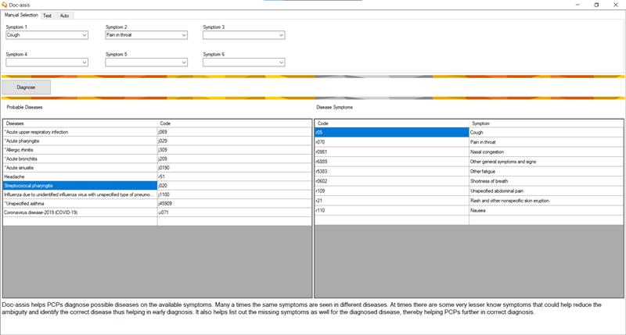
User Interface

Slide 8

Output

Slide 9
VALUE Delivered
Precision
Based on actual Historical Claims Data, therefore prediction will be better and more accurate.
Time Saving
Help in reducing the appointment duration by assisting Providers.
Prognosis
Can Predict severe disease in early stages of consultation.
Cost Saving
Can reduce the number of lab tests performed to diagnose a disease.
ER/Ob Visits
It will be useful in case of ER visits/Observation Events.

Slide 10
Uniqueness & Novelty
3 Modes of Communication
User Friendly GUI supporting multiple modes of communication between Patients and Providers.
Unique Approach
Current tools available in market are basically Chatbots that rely on conversation with patients which can be erroneous. However, DocAssist takes a different approach by empowering the physicians to make better clinical judgement.
Hybrid
Prediction is based on both content and co-occurrence approach.
Prognosis
Can Predict severe disease in early stages of consultation.

Slide 11

GitHub & Video Links
Video link :
https://optum.video.uhc.com/media/DataPilots_DocAssist/1_vik39uwi
GitHub link:
https://github.optum.com/ragarw29/DocAssist
Thank You ☺

